Slide 1

Week 3 Lab Assignment #2
By: Logan Martin

Slide 2
3 Potential problems in this data set:
Omission of race, gender, ethnicity
Name is a feature that doesn’t add value to the research
Missing values under Marital Status feature
Notes:
Omission of potential important data features (race, gender, ethnicity) could make the model bias. Additionally, in my model in particular the names provided in my raw data could cloud the goal of the project. Missing values need to be filled in order to make the model as accurate as possible.

Slide 3
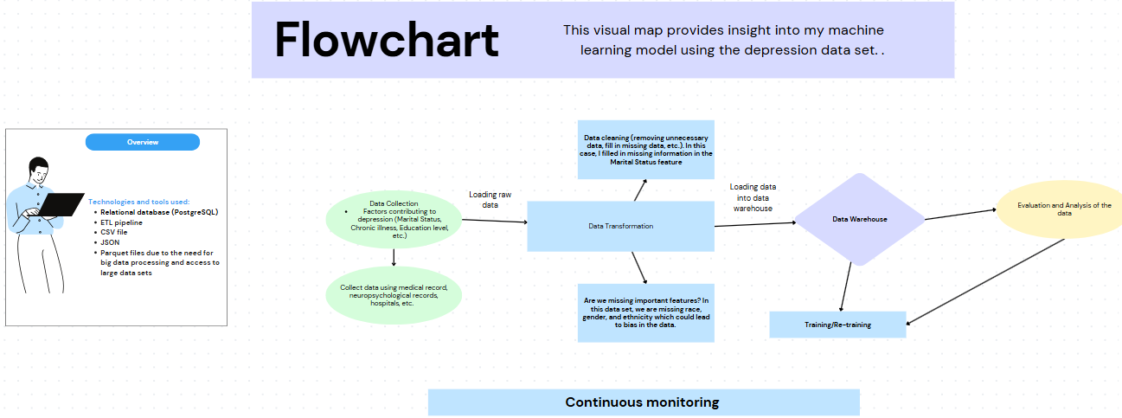

Slide 4
Tools and database used:
Relational database (PostgreSQL)
ETL pipeline
CSV file
JSON
Parquet files due to the need for big data processing and access to large data sets
Notes:
For my model, structured data is a necessity, hence using a relational database. In my model, I chose to use an ETL pipeline because I’d like to clean and manipulate the data prior to training my model. Doing this all at once seems hectic. Also, in this case, near-real time data isn’t a necessity. I chose to use parquet files due to the need for big data processing and access to large data sets.

Slide 5
Plan for Schema changes overtime:
As my model develops and gathers new information, it’s important for consistent monitoring and validation to happen
By monitoring the data, we can add new information as needed and fix any bias along the way that affects the accuracy as the data changes
Using Validation technique, we can spot features with missing values and potentially combine features to help with model accuracy

Slide 6
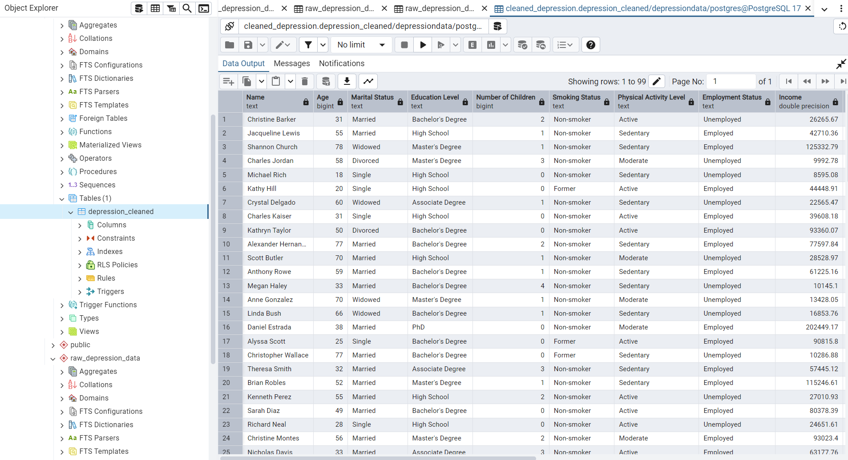
Notes:
Screenshot of my new cleaned data uploaded using pgAdmin.

